Slide 1
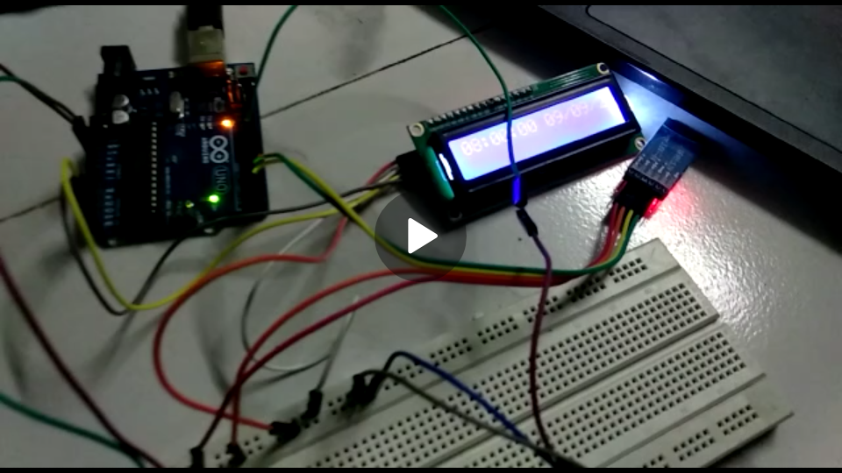
(Permanently Affiliated to University of Mumbai)
AUTOMATED COLLEGE BELL SYSYTEM

Slide 2
(Permanently Affiliated to University of Mumbai)
OVERVIEW
The AUTOMATED COLLEGE BELL SYSYTEM is made to overcome the errors in manual bell ringing and to maintain accuracy in the time constraints.
Real Time and Date is considered and displayed. Customization can also be done
The components used are mentioned ahead , the circuitry is also considered.
The working of the project and also the applications are looked upon.

Slide 3
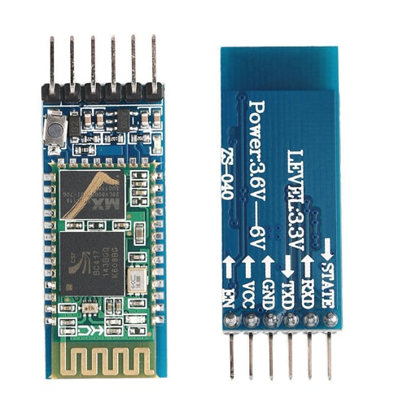
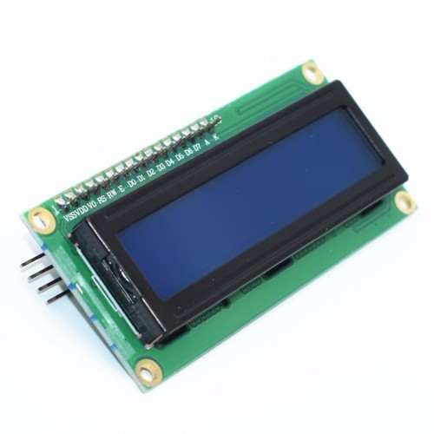
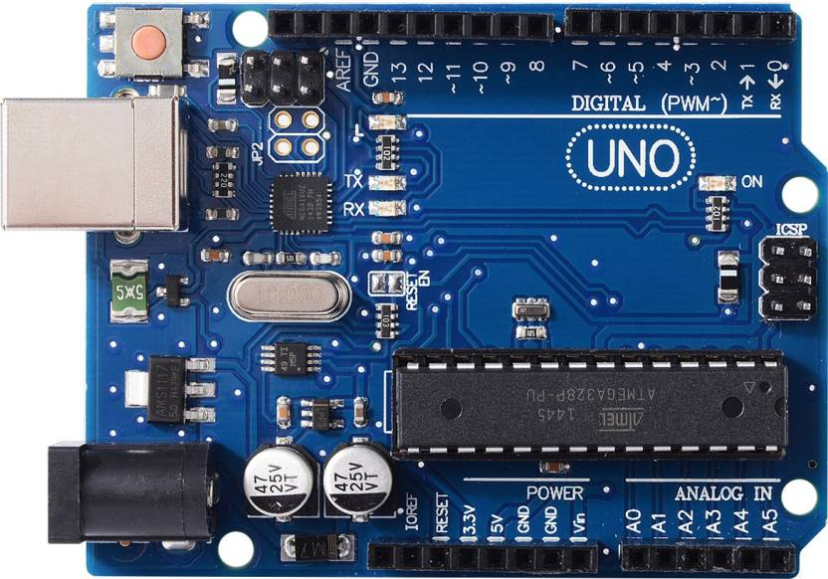
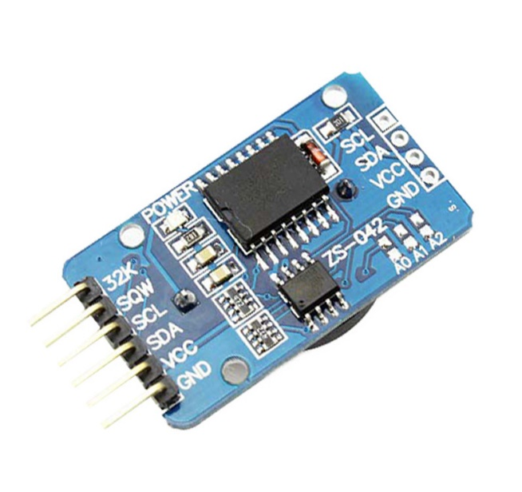
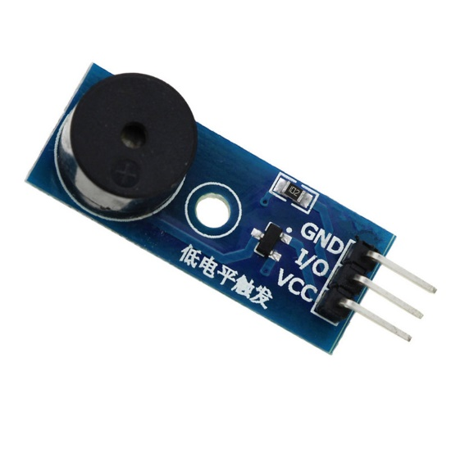
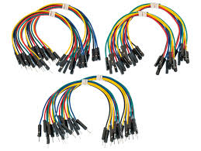
(Permanently Affiliated to University of Mumbai)
ARDUINO UNO
BLUETOOTH MODULE HC05
I2C LCD
BUZZER MODULE
JUMPER WIRES
RTC DS3231

Slide 4
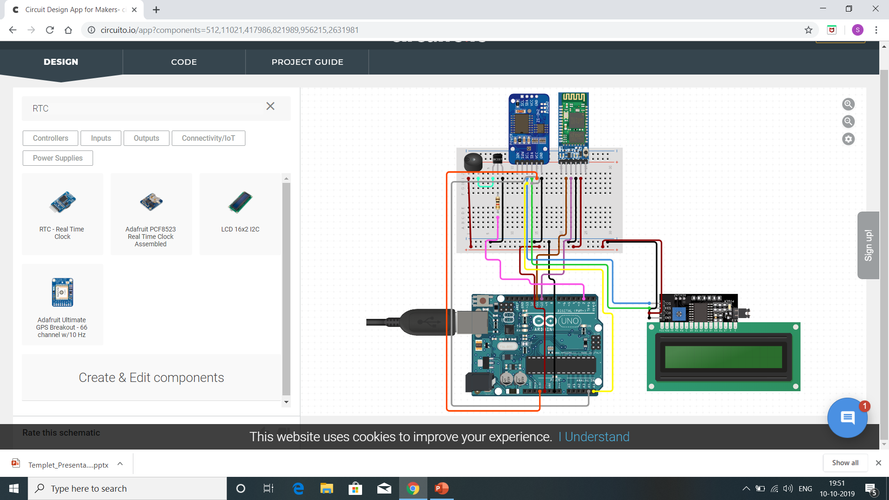
(Permanently Affiliated to University of Mumbai)
CIRCUITRY

Slide 5
(Permanently Affiliated to University of Mumbai)
FLOWCHART
START
If Custom Mode selected
YES
NO
If Regular Mode selected
Exam Mode
NO
YES
If Real time equal to the bell ringing time
YES
Ring the Buzzer
NO

Slide 6
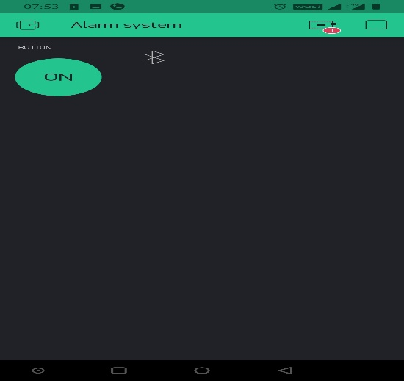
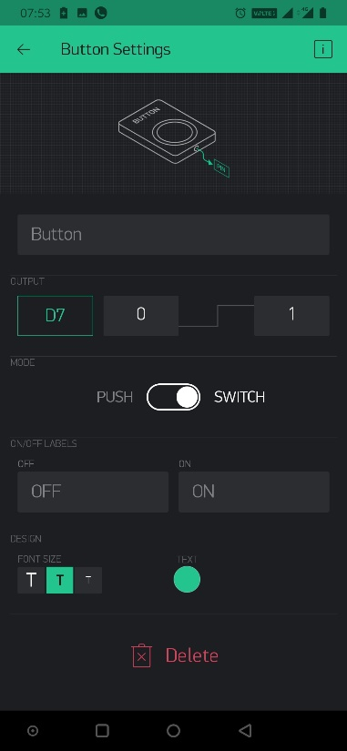
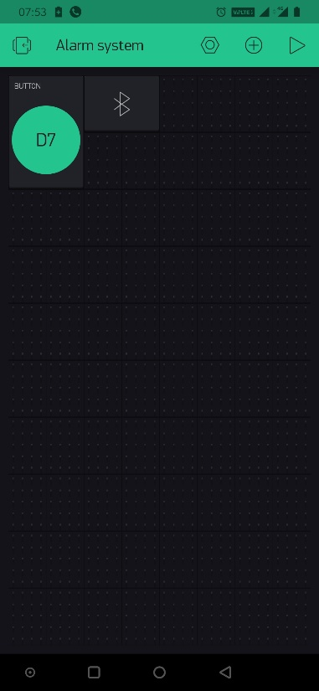
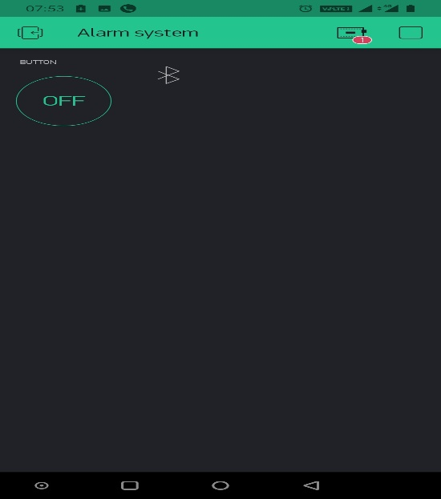
(Permanently Affiliated to University of Mumbai)
The Blynk app is used to connect the Bluetooth Module HC-05 to the android phone so that various operation could be performed

Slide 7
(Permanently Affiliated to University of Mumbai)
BLOCK DIAGRAM
PC
POWER SUPPLY
I2C 16x2 LCD
ARDUINO UNO
RTC DS3231
BUZZER (OR) BELL
BLUETOOTH MODULE HC-05

Slide 8
(Permanently Affiliated to University of Mumbai)
APPLICATIONS
Security
Abc

Slide 9
(Permanently Affiliated to University of Mumbai)

Slide 10
(Permanently Affiliated to University of Mumbai)

